Slide 1
TX FIR Equalizer – CML mode
12 Gbps
(Final Report)
Muhammad Aldacher

Slide 2
Outline
Background
Implementation
Schematics
Design Steps
Simulation Results
Pulse Response
Eye Diagram
Transient Waveforms

Slide 3
Background
"TX FIR equalization" is the technique in which a transmitter applies a Finite Impulse Response (FIR) filter to pre-distort the signal before sending it.
This is to compensate for the distortions introduced by the transmission channel, thus improving signal quality at the receiver by mitigating intersymbol interference (ISI).

Slide 4
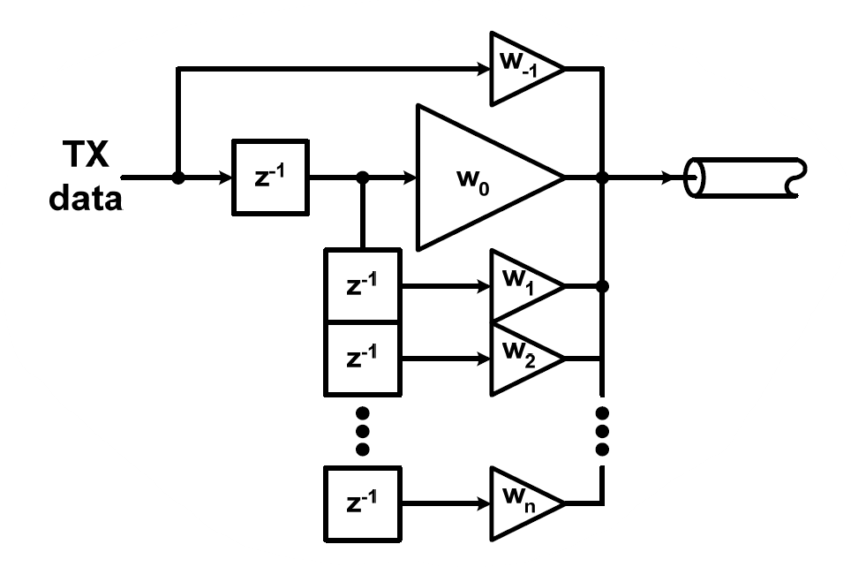
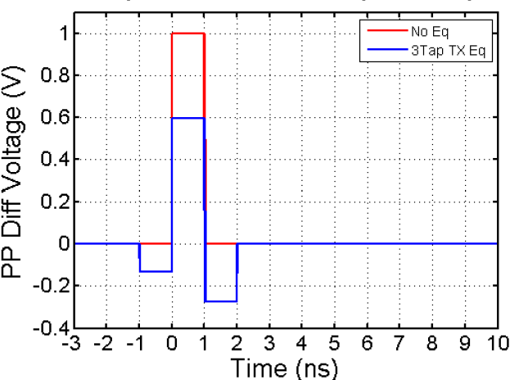
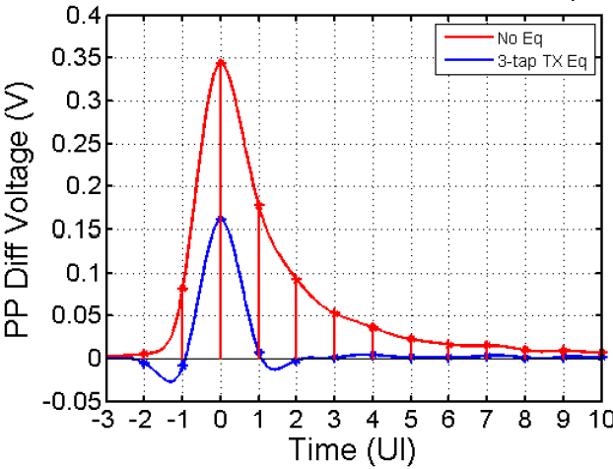
Background
Time Domain
Input Pulse w/ 3-tap TX Eq
Output Pulse Response

Slide 5
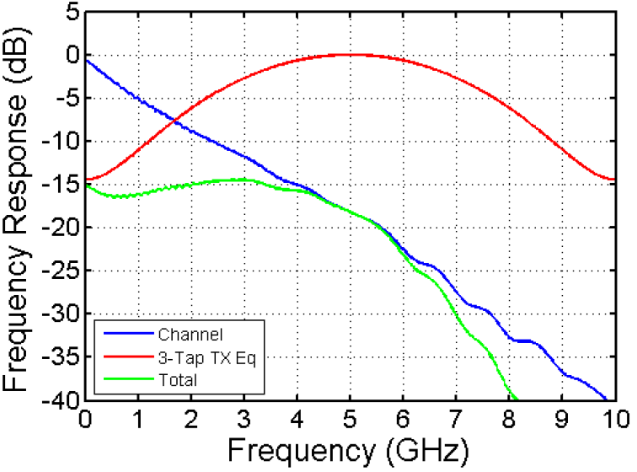
Background
Freq Domain
Channel Response w/ TX FIR Eq

Slide 6




Implementation
For CML driver:

Slide 7

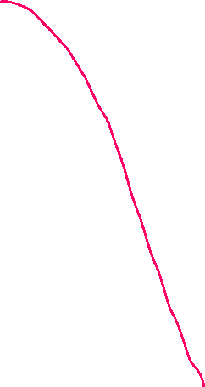


Implementation
For CML driver:

Slide 8
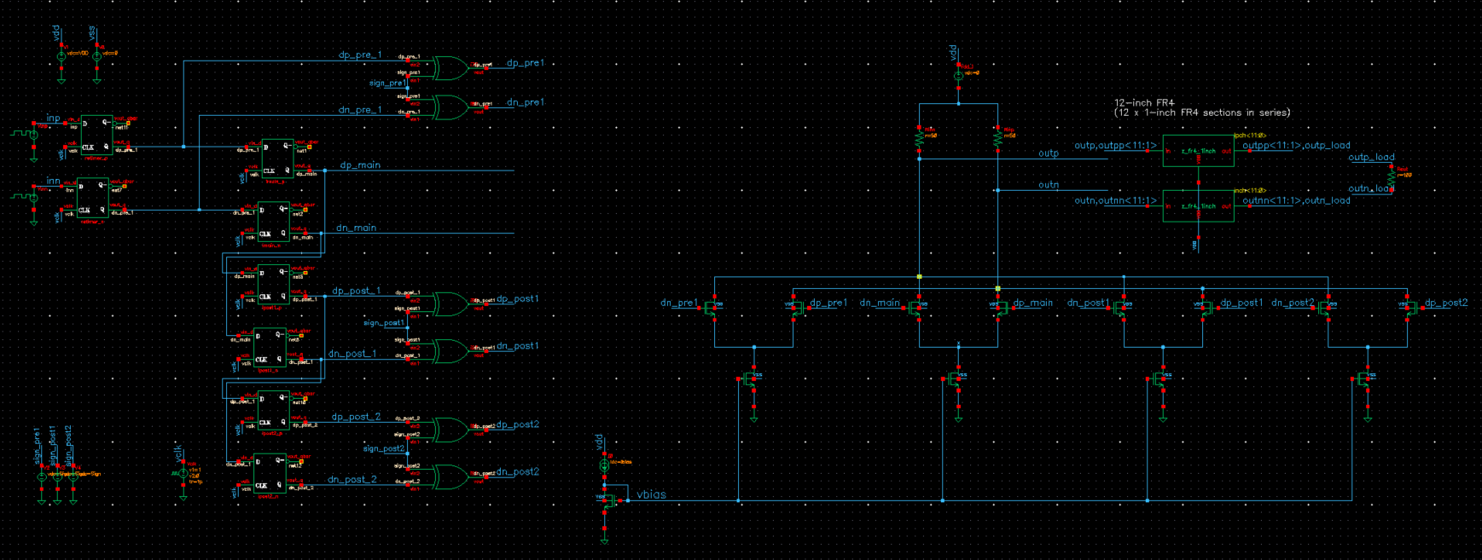
Schematics
FIR logic
CML Driver
Channel & Load

Slide 9
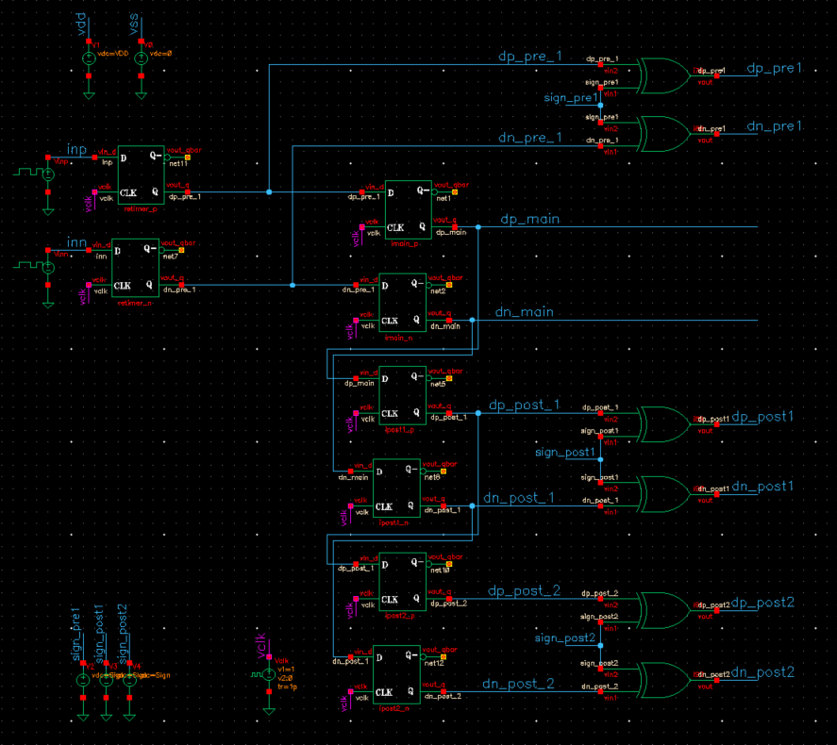
Schematics
A) FIR Logic:
Pre-Cursor 1
12 Gb/s PRBS Inputs
Main-Cursor
Flipflops used to align the input data to the FF edges
Post-Cursor 1
12 GHz Clock
Post-Cursor 2
Flipflops used as delay cells
XOR gates used to apply the sign to the cursor taps

Slide 10
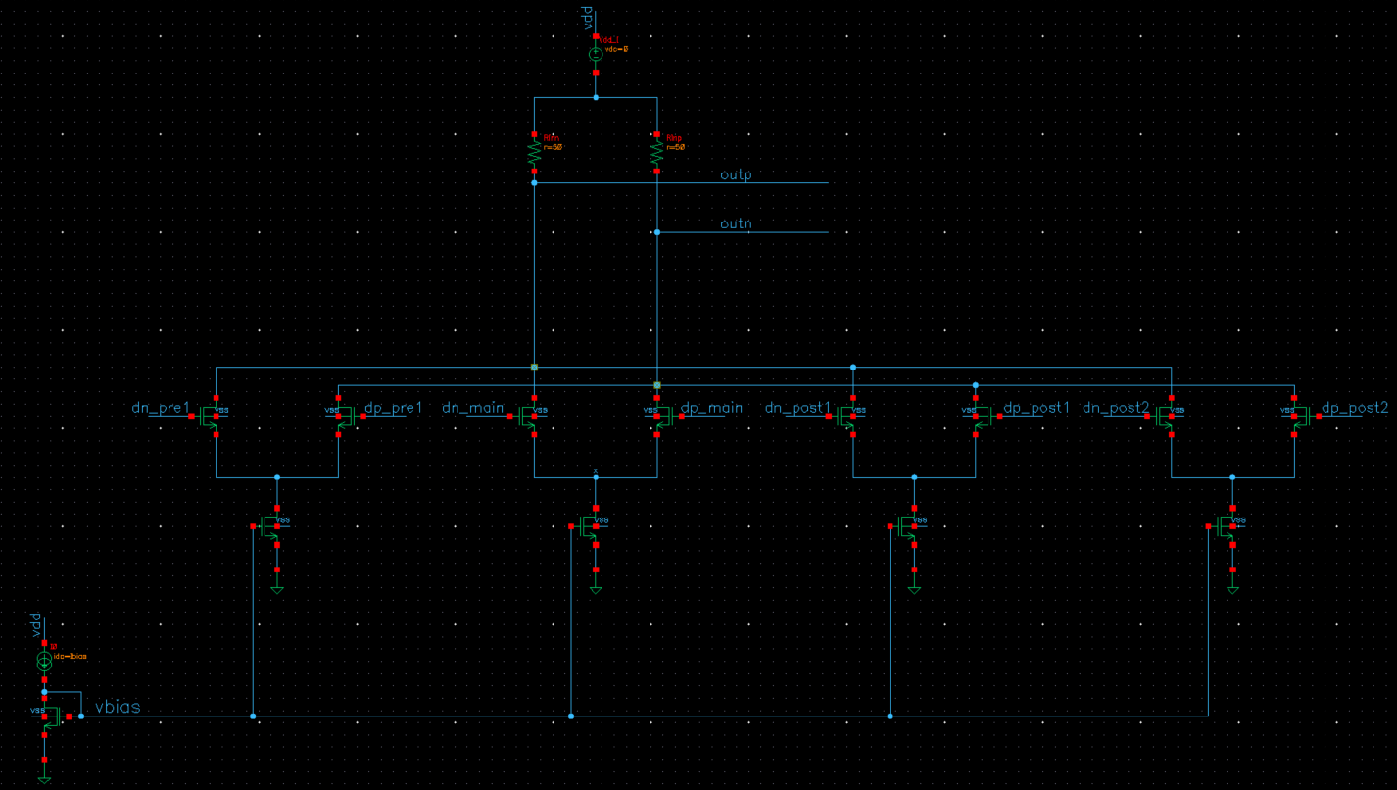
Schematics
B) CML Driver:
Pre1
Main
Post1
Post2
m=100 L=LMIN
m=100 L=LMIN
m=100 L=LMIN
m=100 L=LMIN
IPRE1=0.6mA
IMAIN=10mA
IPOST1=2.9mA
IPOST2=1.4mA
m=12 L=4*LMIN
m=200 L=4*LMIN
m=58 L=4*LMIN
m=28 L=4*LMIN
m=200 L=4*LMIN

Slide 11
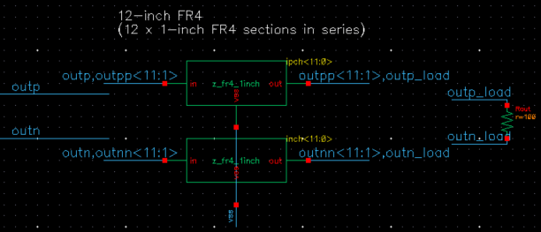
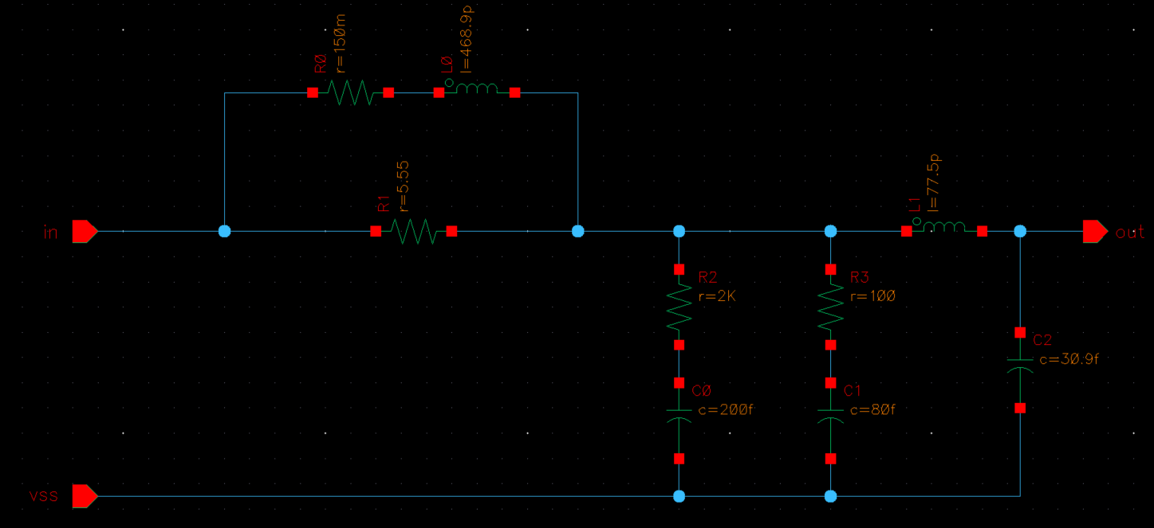
Schematics
C) Channel & Load:
1-inch FR4 section

Slide 12
Design Steps
Design the Tx-Driver at a low data-rate & without equalization as shown in this project (Tx-Driver Design)
Plot the pulse response of this Tx-Driver at the desired data-rate.
Calculate the pre & post cursors from the pulse response.
Modify the Tx-Driver design by adding weighted taps based on the cursors’ values.
Plot the eye diagram to see how much the eye opening improved.

Slide 13
Design Parameters
Parameter | Value
Data Rate | 12 Gb/s
VDD | 1 V
Tx-Driver | Current Mode (CML)
VSWING (PK2PK) | 0.5 V
IBIAS | 10mA
Channel | 12-inch FR4

Slide 14
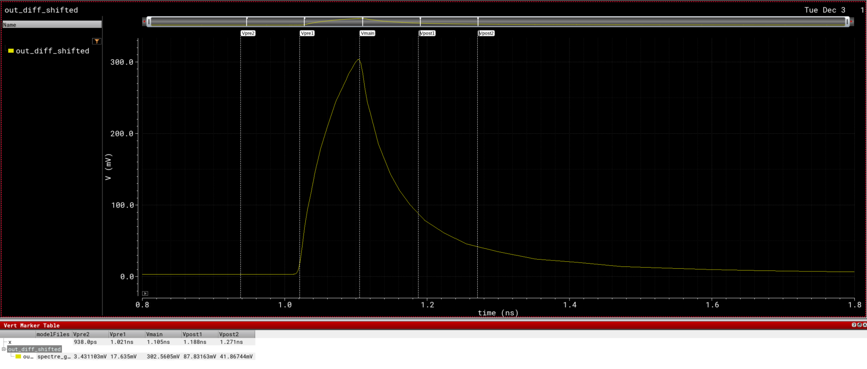
Simulation Results
A) Pulse Response:
(Without Equalization)
 | Pre- Cursor1 | Main- Cursor | Post- Cursor1 | Post- Cursor2
Adjusted VSWING(PK2PK) | (18 / 303) * 500 mV = 29.7 mV | (303 / 303) * 500 mV = 500 mV | (88 / 303) * 500 mV = 145.2 mV | (42 / 303) * 500 mV = 69.3 mV
Equivalent IBIAS | 29.7 mV / 50 Ohms = 0.6 mA | 500 mV / 50 Ohms = 10 mA | 145.2 mV / 50 Ohms = 2.9 mA | 69.3 mV / 50 Ohms = 1.4 mA
# of fingers | (m = 12) | (m = 200) | (m = 58) | (m = 28)
Pre-Cursor1 = 18mV
Main-Cursor = 303mV
Post-Cursor1 = 88mV
Post-Cursor2 = 42mV

Slide 15
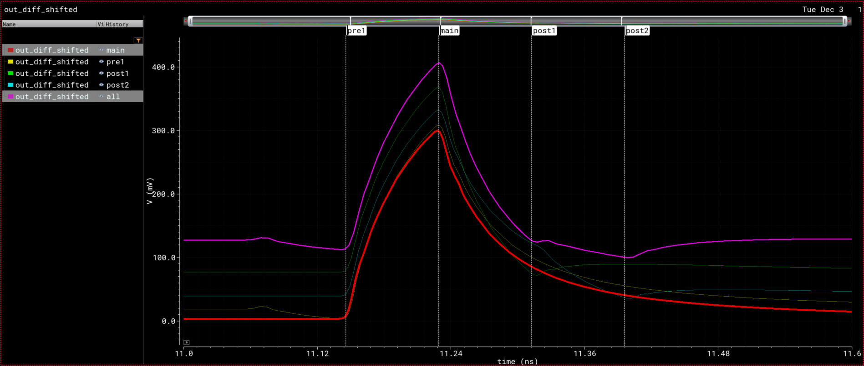
Simulation Results
A) Pulse Response:
(With Equalization)
No Equalization
Pre-Cursor1 Eq only
Post-Cursor1 Eq only
Post-Cursor2 Eq only
4-tap Eq (1pre, main, 2post)

Slide 16
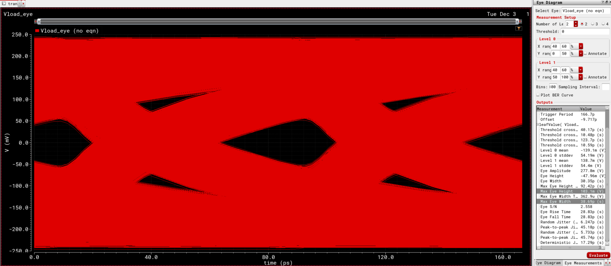
Simulation Results
B) Eye Diagram:
(Without Equalization)
103.1 mV
38.69 ps

Slide 17
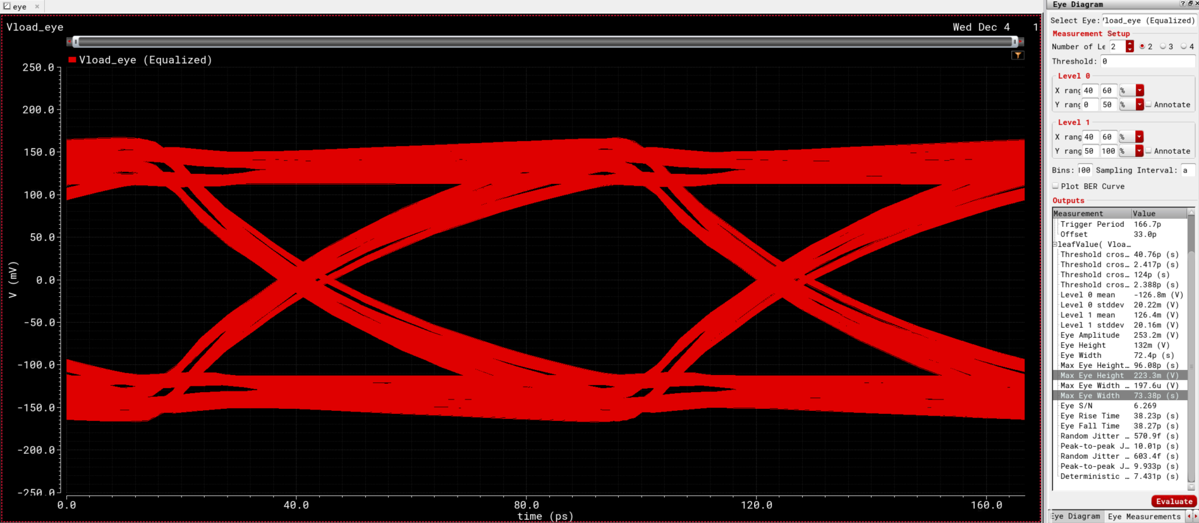
Simulation Results
B) Eye Diagram:
(With Equalization)
223.3 mV
73.38 ps

Slide 18
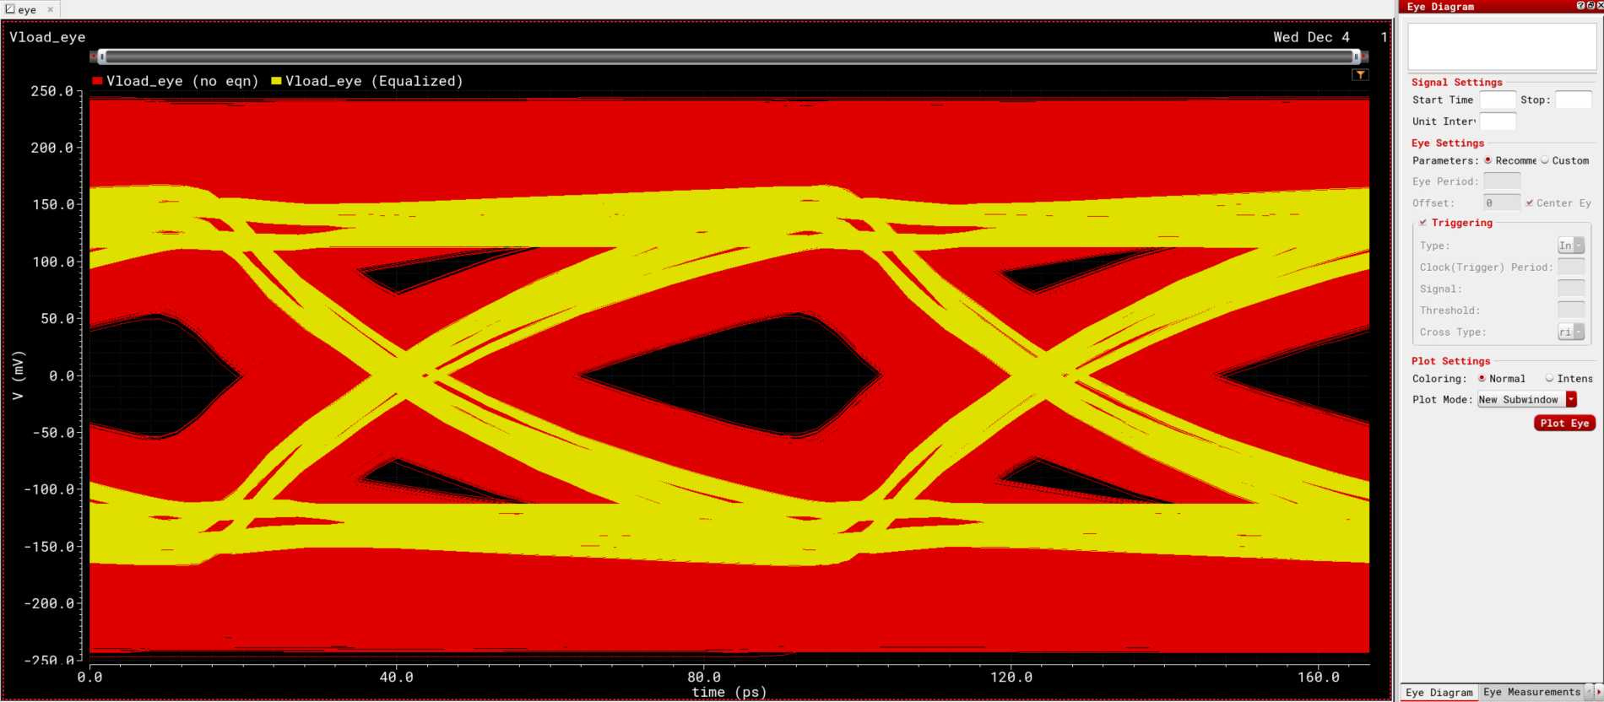
Simulation Results
 | No Equalization | With Equalization (4-tap)
Eye Height (Max) | 103.1 mV | 223.3 mV
Eye Width (Max) | 38.69 ps | 73.38 ps
Swing (PK2PK) | 500 mV (–250mV ~ +250mV) | 328 mV (–164mV ~ +164mV)
B) Eye Diagram:

Slide 19
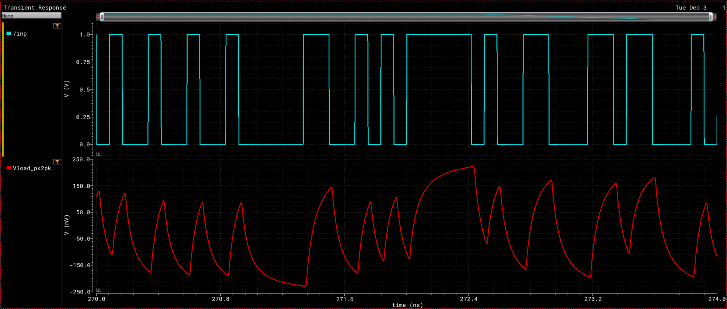
Simulation Results
C) Transient Waveforms:
(Without Equalization)

Slide 20
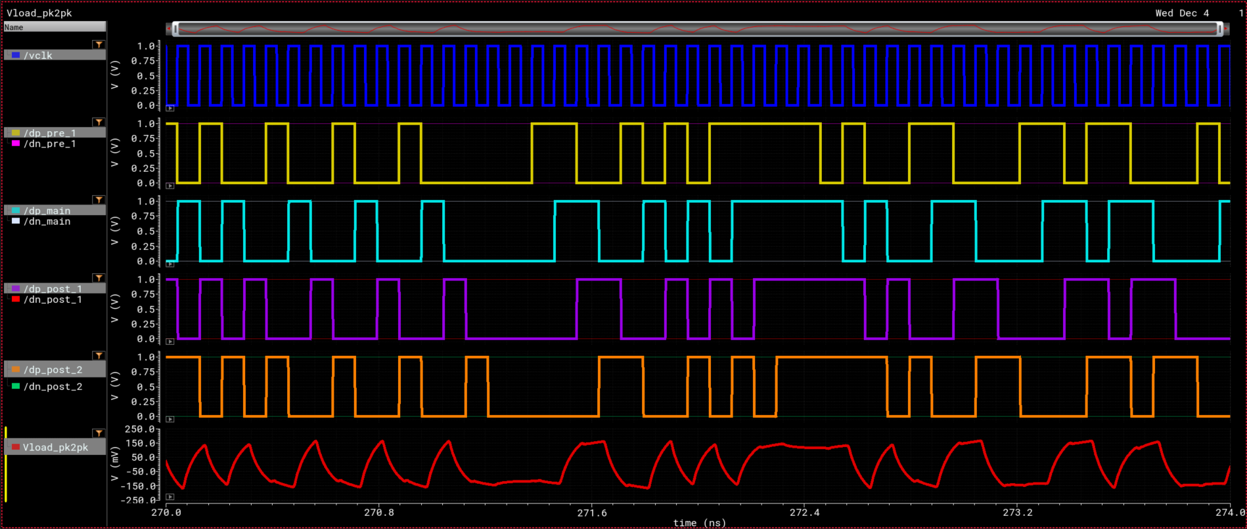
Simulation Results
C) Transient Waveforms:
(With Equalization)

Slide 21
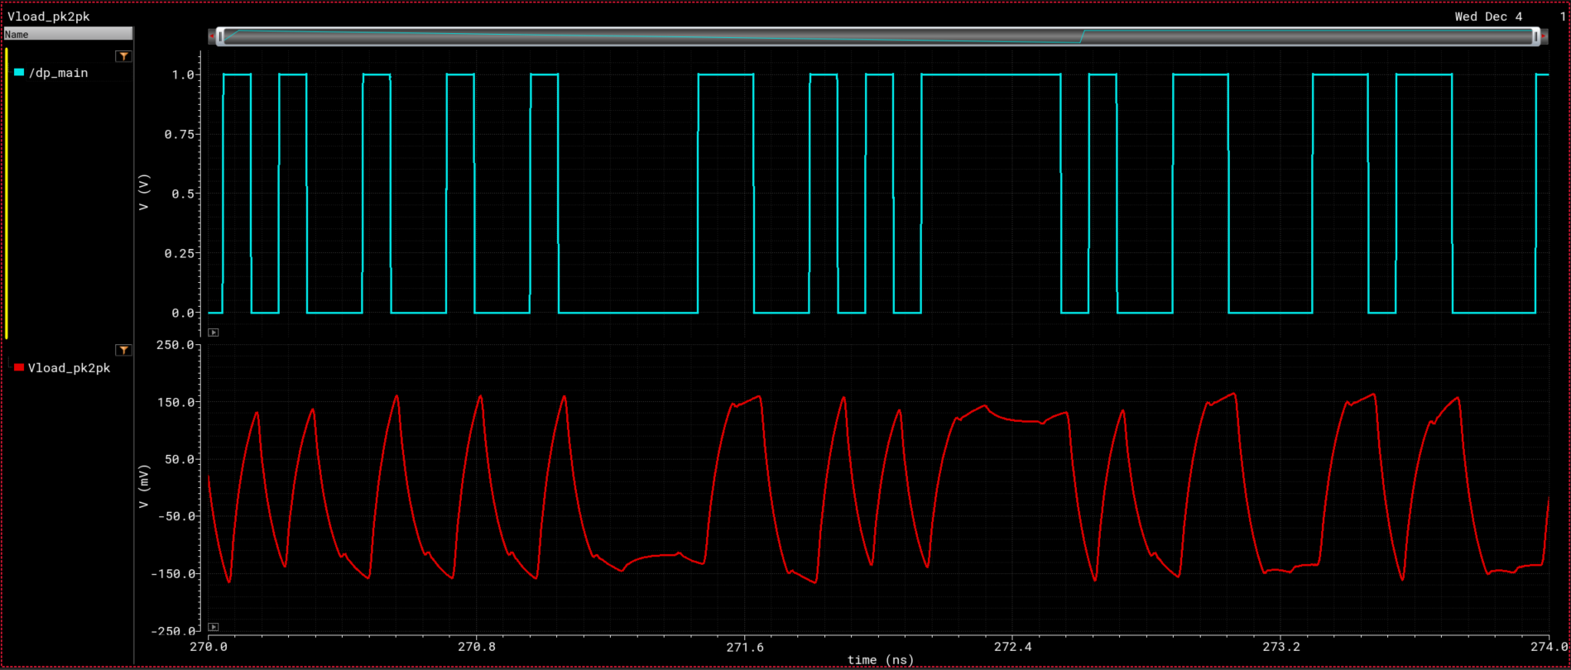
Simulation Results
C) Transient Waveforms:
(With Equalization)

Slide 22
Conclusion
This project shows the design procedure of a TX FIR Equalizer for a 12 Gb/s input & a channel of 12-inch FR4.
It also shows how the equalization improves the eye opening of the output, while paying the price of lower swing amplitude & increased latency.

